Slide 1

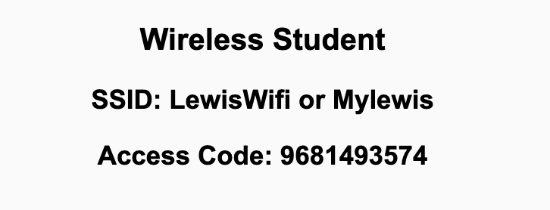
Preflight Check List
Web and Distributed Programming Eric Pogue
Sign into our Zoom meeting through our integrated Blackboard/Zoom link
Make sure that you can hear the conversation, see shared desktops, and view chat topics
You will eventually need to be able to share your computer screen
You will eventually need a headset with a microphone to be able to effectively listen and speak
Thank you if you choose to leave your camera on to help make our class more interactive
In person participants also:
Make sure that your microphone and speakers are muted/off so that we don’t get an echo
Sit in a good spot near the classroom ceiling microphones if possible

Slide 2
Recordings
Discuss that recording are:
Opportunistic
Automatically available in Blackboard/Zoom
Start Recording

Slide 3
Web and Distributed Programming
Eric Pogue

Slide 4
Agenda:
Prework and Announcements
Team Communications Tools
Polling
Introductions – Part 1
Sprint 1 Planning (abbreviated)
Assignment
Introductions – Part 2 including Scrum Team Assignments
Discussion & Questions welcome at any time but please be present with no phones or email during our time together

Slide 5
Prework & Announcements
Welcome Message
Blended Learning
Scrum

Slide 6
Team Communications Tools
We will be using Zoom for class
What is your preferred small team communication tool?
Do you have a Discord account?

Slide 7
Polling

Slide 8
Class Format
Synchronous vs Asynchronous
Local (In Person) vs Remote
We will be in person Mondays and Wednesdays and remote on Friday

Slide 9
Class Format Discussion
Synchronous vs Asynchronous
Local (In Person) vs Remote
We will be in person Mondays and Wednesdays and remote on Friday
It may be possible that some individuals or teams to participate remotely on other days as long as they are able to actively participate in class and with their scrum team.
How do we want to handle that given our priorities of?
Health and safety
Intended course schedule
Effective teaming and association

Slide 10
Introductions

Slide 11
Foreshadowing Your Introductions
Be prepared to share your:
Preferred name and seat number
Year & Major
Your in person class preferences (Monday and Wednesday assumed)
One or two things your would like to get from this class
Programming Experience (1 to 5)
Favorite hobby and/or an interesting fun fact
Favorite “adjective/noun” scrum team name (this can be original, one from the following slide, or you can even “pass” on this one if you want)
Preference of being added to an existing scrum team or start a new a scrum team

Slide 12
Scrum Team Names
Scrum team names from previous semesters:
TeamFun
SwagMoney
MonaLisas
Scrumdiddlyumptious
FightingBass
MysticMungis
TitanicSwimTeam
VirtuallyScrumming
GloriousKenobis
RedDragons
Mongooses
Scrumples
WubbaLubbaDubDubs
RedPandas
PurpleSalamanders
MadSanitizers
SpeedCoders
StingyTadpoles
BlueThrees
PurpleCobras
LaughableCaterpillars
PurplePirates
ScrumIsFum
ScrummyScrumbags
TheCrew
WickedCrew
SpicyChalupa
WubbaLubbaDubDubs
Notes:
Hand out name tags and introduction forms before Syllabus Overview

Slide 13
Introductions – Part 1

Slide 14
Introductions
Full and Preferred Name:
Eric Pogue
Eric, Mr. Pogue, or Professor
Family, Home, College background:
Married with five children, relocated from Davenport, IA to Chicago area
Undergraduate in CS and Masters in Business… teaching evenings for many years
Programming experience:
Decades in the industry as a developer, architect, project manager, division manager, and vice president of various software development organizations
Part of many teams that have delivered products to ten’s of millions of customers globally
Parsons Technology, Intuit, The Learning Company, Jasc Software, and John Deere
… and most recently working on a startup product “Stadia” with my oldest son
Second year teaching full-time

Slide 15








Slide 16
Introductions
Likely programming environment
MacOS, Terminal, Visual Studio Code, and Chrome/Firefox web browser
Top two or three things that you would like to get out of this class
To learn something myself while helping each of you be successful
Motivate you to look deeper while we are exploring technologies and processes
Help you build something that makes you proud during the semester
Hobbies:
Wilderness Canoeing & Camping (Quetico) and Triathlons
Fun Fact:
At one point I had the very dubious “honor” or being the most traveled John Deere employee to India with 40+ trips over a 5-6 year period while setting up the 400+ person John Deere Technology Center – India Software Development organization.
Notes:
Vanity

Slide 17


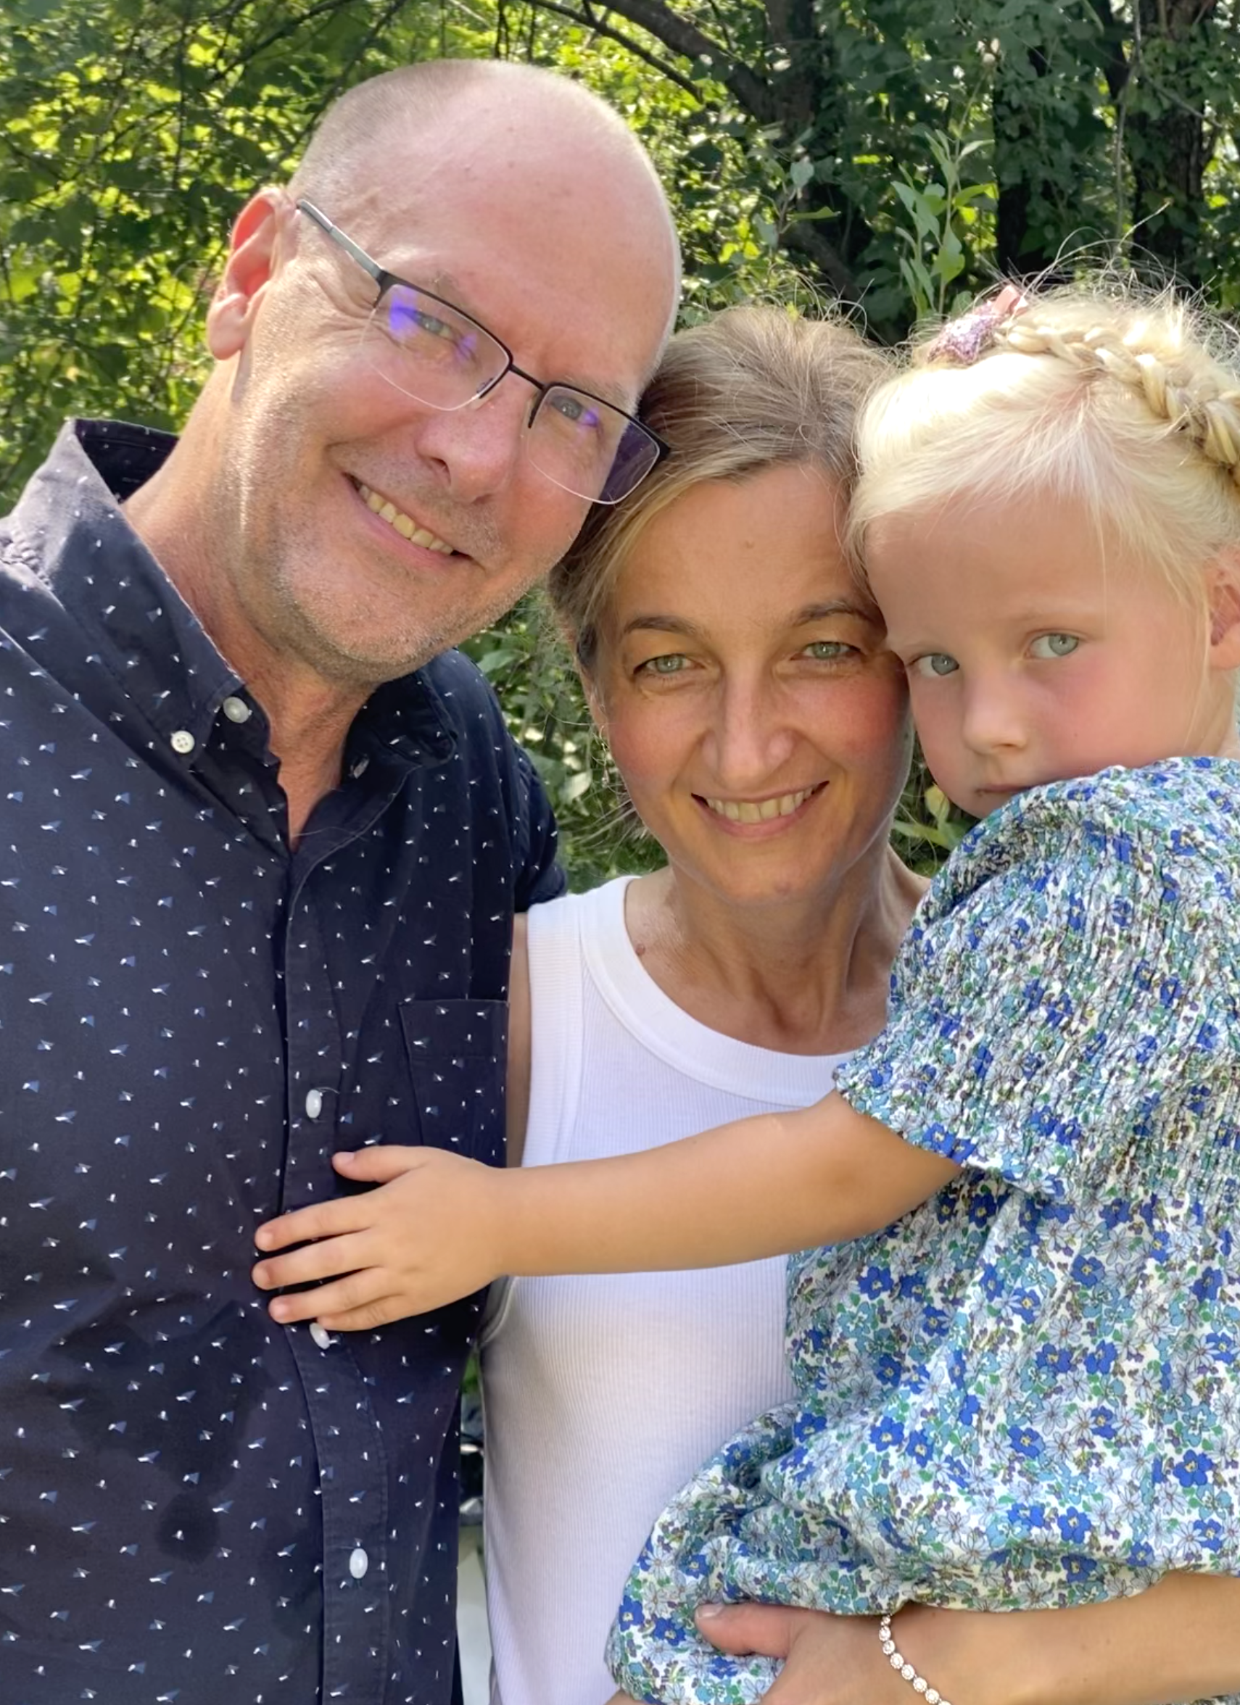
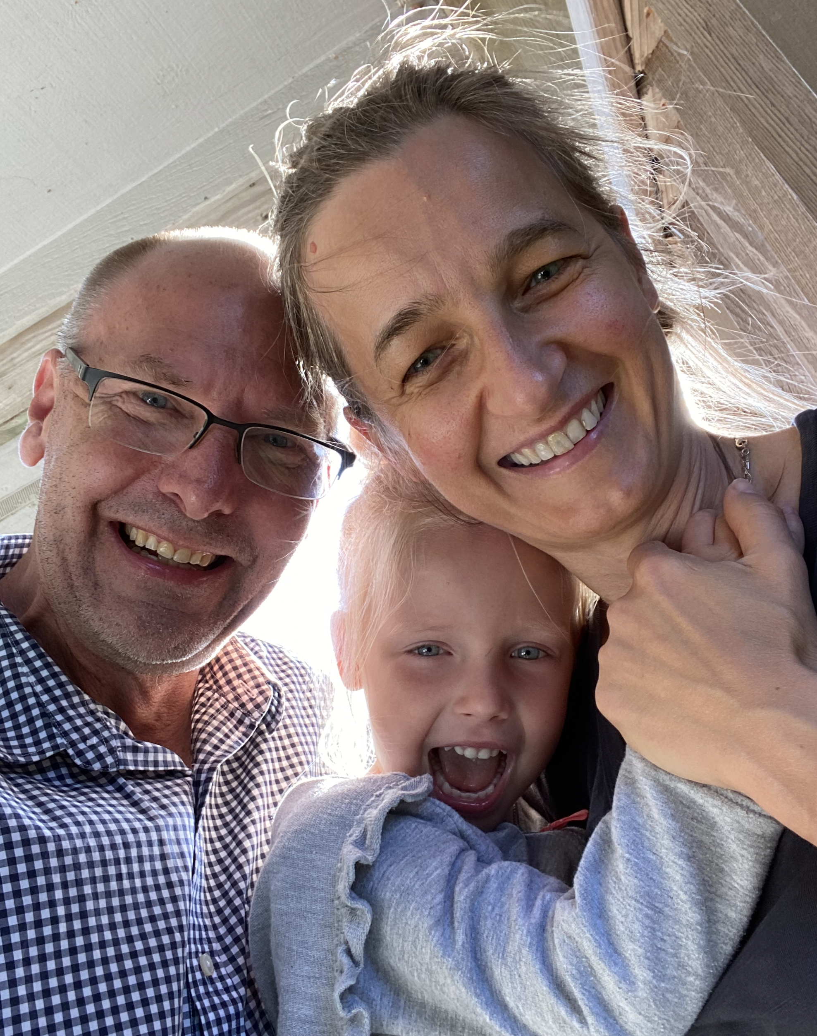
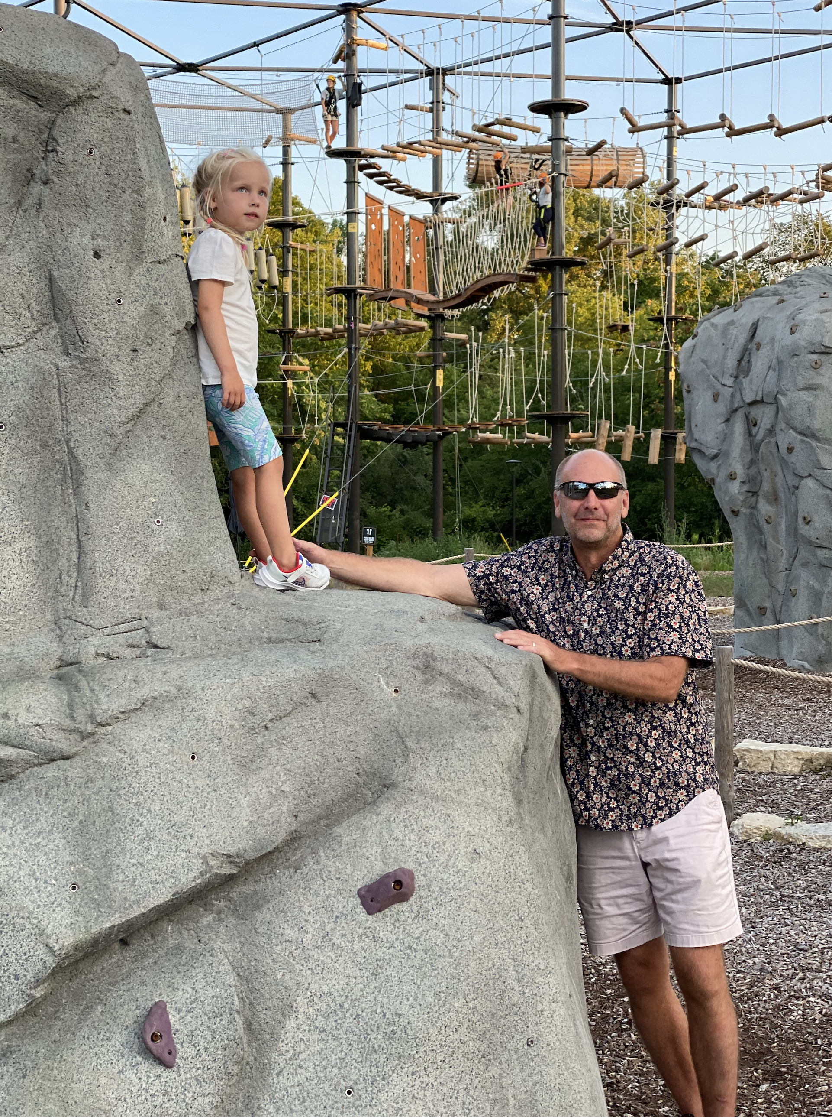


Slide 18
Sprint 1 Planning (abbreviated)

Slide 19
Sprint Planning
We will be doing sprint planning at the beginning of each of our 8 sprints during the semester.
What’s different about Sprint 1 planning?
We will need to finish Sprint 1 planning on Wednesday because we want to make sure that we have time for Introductions and initial Scrum Team assignments today
Next Monday is a Holiday so we will be missing one class session

Slide 20

Scrum Process – Sprint Planning
By Dr ian mitchell - Own work, CC BY-SA 4.0, Link

Slide 21
Review Announcement, Activities List,
Assignments, and Syllabus

Slide 22
Sprint Planning
(to be continued Wednesday)

Slide 23
Prework For Next Class
Complete through activity 6 prior to next class
Be ready to test your scrum team discussion capabilities with your team Discord server*
Get your headset (that includes a microphone) for teaming and programming together activities

Slide 24



Headset Options
What would I recommend?
Airpods or Comparable Sennheiser
Maybe Gaming
Headphones?

Slide 25
Questions?
Complete through activity 6 prior to next class
Be ready to test your scrum team discussion capabilities with your team Discord server*
Get your headset (that includes a microphone) for teaming and programming together activities

Slide 26
Introductions – Part 2

Slide 27
Scrum Team Names
Scrum team names from previous semesters:
TeamFun
SwagMoney
MonaLisas
Scrumdiddlyumptious
FightingBass
MysticMungis
TitanicSwimTeam
VirtuallyScrumming
GloriousKenobis
RedDragons
Mongooses
Scrumples
WubbaLubbaDubDubs
RedPandas
PurpleSalamanders
MadSanitizers
SpeedCoders
StingyTadpoles
BlueThrees
PurpleCobras
LaughableCaterpillars
PurplePirates
ScrumIsFum
ScrummyScrumbags
TheCrew
WickedCrew
SpicyChalupa
WubbaLubbaDubDubs
Notes:
Hand out name tags and introduction forms before Syllabus Overview

Slide 28
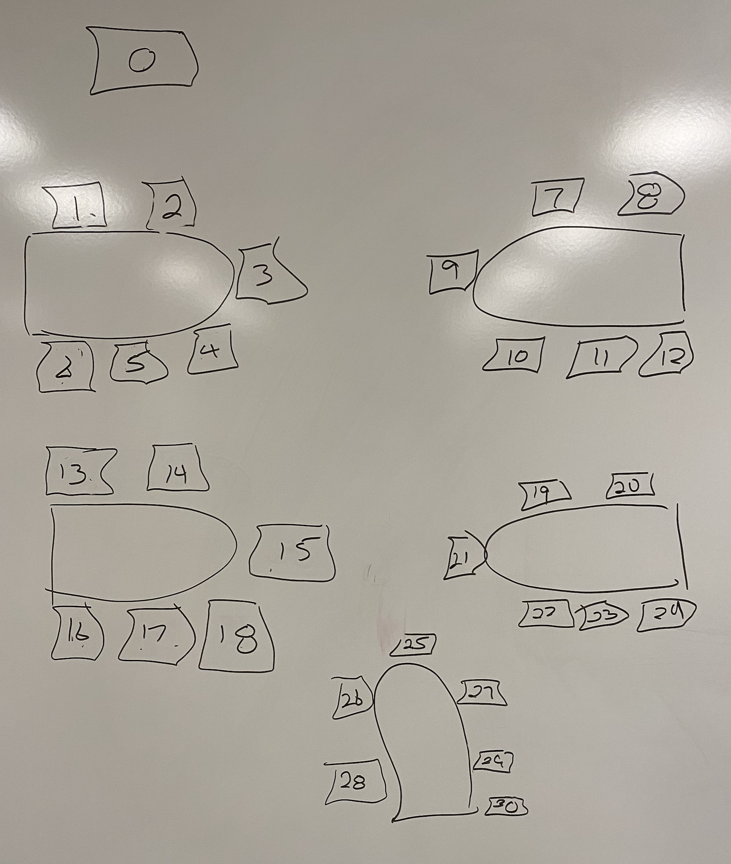
Foreshadowing Your Introductions
Be prepared to share your:
Preferred name and seat number
Year & Major
Your in person class preferences (Monday and Wednesday assumed)
One or two things your would like to get from this class
Programming Experience (1 to 5)
Favorite hobby and/or an interesting fun fact
Favorite “adjective/noun” scrum team name (this can be original, one from the following slide, or you can even “pass” on this one if you want)
Preference of being added to an existing scrum team or start a new a scrum team

Slide 29
End of Session

